Slide 1
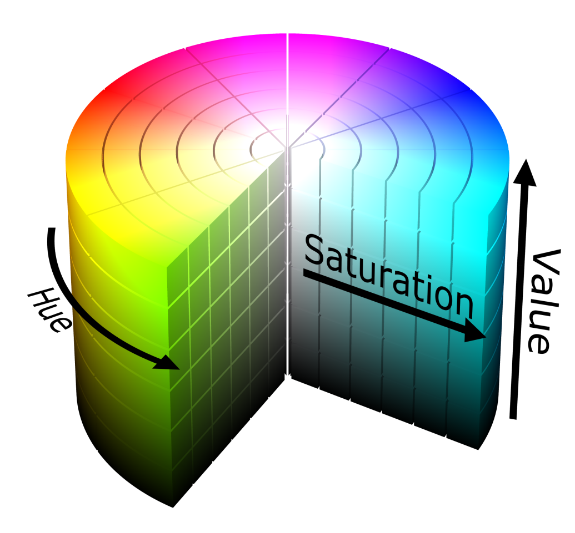
HSV Image model
HSV is a cylindrical coordinate representation of points in RGB color model.
More intuitive and perceptually relevant than the Cartesian representation.
HSV stands for hue , saturation, and value.
In each cylinder the angle around the central vertical axis corresponds to hue.
The distance from the axis corresponds to saturation.
The distance along the axis corresponds to intensity , value or brightness.

Slide 2

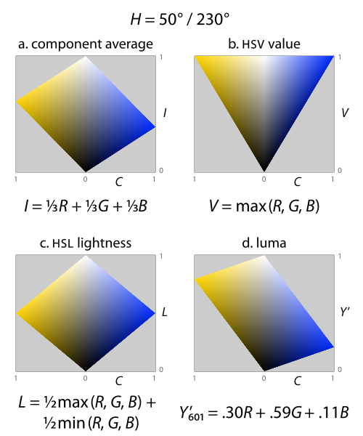
HSV continued..
This places all three primaries, and also all of the "secondary colors"—cyan, yellow, and magenta—into a plane with white, forming a hexagonal pyramid out of the RGB cube.^{[8]}
Hue is one of the main properties of a color. defined technically as "the degree to which a stimulus can be described as similar to or different from stimuli that are described as red, green, blue, and yellow.”
The saturation of a color is determined by a combination of light intensity and how much it is distributed across the spectrum of different wavelengths.
The value is defined as the largest component of a color. This places all three primaries, and also all of the "secondary colors"—cyan, yellow, and magenta—into a plane with white, forming a hexagonal pyramid out of the RGB cube.^{[8]}
Hue in the HSB/HSL encodings of RGB

Slide 3
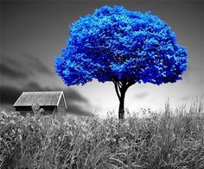
Color pop
About the project :-
Converts the Image into a grey scale and pops only a particular color or selected range of colors.
Used in photoshop and editing photos for bringing creativity into the pictures.
Change only a particular color in the image to another so that it looks more prominent by making the background as grayscale.

Slide 4
Why Conversion from RGB to HSV?
Unlike RGB, HSV separates luma, or the image intensity, from chroma or the color information.
In case of a shadow in an image, all the RGB values will be effected, if we had used a HSV model, only the saturation and intensity plane value is affected, whereas the hue plane value ( the primary color ) doesn’t change much.
In our project, basic need for conversion was for the following reasons :
Getting a separate hue plane so that a selective color can be popped or changed to another color.
Making all the saturation values of entries other than selected color to 0 to make it grayscale.
This acts as a background and the selected color appears to be “popped out” from the image.

Slide 5
Flow Chart
Original Image
Convert RGB to HSV
Select Hue and Saturation Planes
Select a particular color or range of colors
Update the saturation values of non selected pixels to 0
Update Saturation Plane in HSV Image
Change the hue values of selected color
( optional, used in second implementation)
Convert Image back to RGB
Notes:
Original Image
Convert RGB to HSV
Select Hue and Saturation Planes
Select a particular color or range of colors
Update the saturation values of non selected pixels to 0
Update Saturation Plane in HSV Image
Change the hue values of selected color
( optional, used in second implementation)
Convert Image back to RGB

Slide 6
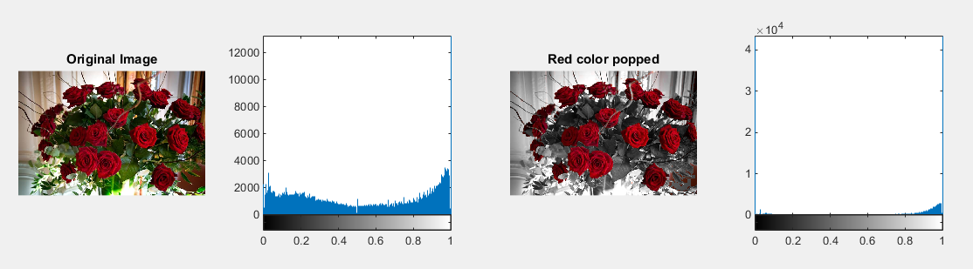
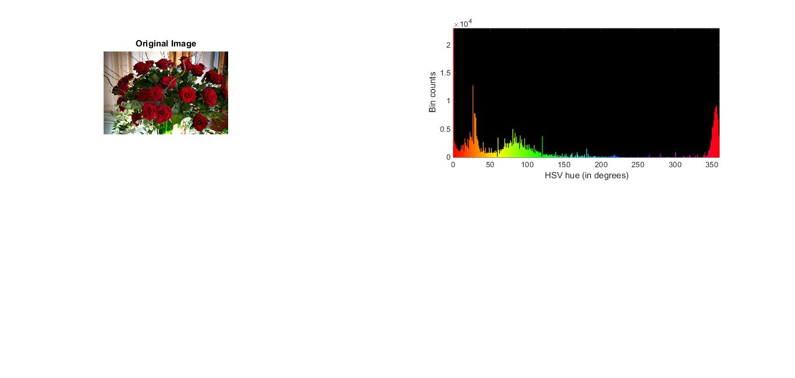
Color pop
Implementation:-
convert the image to HSV image.

Slide 7

Color pop
Get the saturation plane

Slide 8
Color pop
Select non red pixels
Set the selected pixel saturation to 0

Slide 9
Color pop
Update the saturation plane.

Slide 10
Color pop
Convert the image back to rgb.

Slide 11
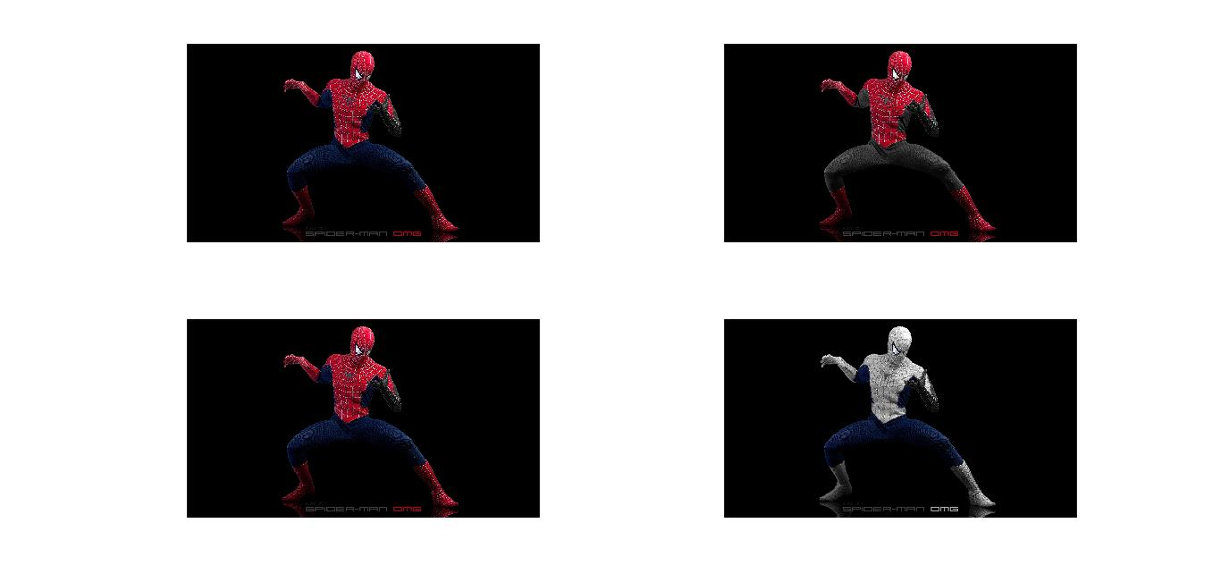
Color pop

Slide 12
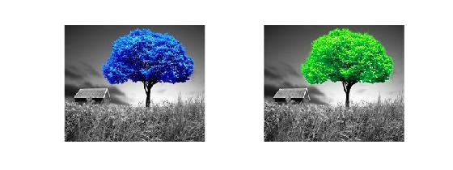
Other implementations
Popping more than one color at a time in the same image.
We have to be more careful in this implementation as we get some colors that may appear red might have more hue value of orange and will not be popped out as we might have expected. So we have to select the range of colors carefully.
Transition of one color to another
without effecting other colors in the
image.
Select the hue plane of the selected color.
Update the hue values to the output color as required.
Update the saturation values of non selected pixels to 0 if required.

Slide 13
References
dsp.stackexchange.com
http://www.workwithcolor.com/hsl-color-picker-01.htm
www.stackoverflow.com

